Slide 1
PHISHING AWARENESS TRAINING
-Khalil Jibran

Slide 2
PHISHING
Phishing is a type of cyber attack where attackers masquerade as a trustworthy entity to trick individuals into sharing sensitive information like passwords or credit card details, often via email or fake websites.

Slide 3
COMMON TYPES OF PHISHING
Email Phishing
Spear Phishing
Whaling

Slide 4
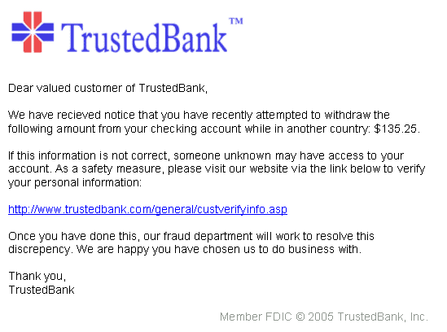

EMAIL PHISHING
Email phishing is the most traditional and widespread form of phishing. Attackers send emails that appear to come from legitimate sources, such as banks, social media platforms, or employers. These emails often contain malicious links or attachments designed to steal personal information or deliver malware.

Slide 5

SPOTTING EMAIL PHISHING
Name, Email and Phone Number don’t seem matching (are fake).
Spelling and Grammar Mistakes.
Spam messages.
Fake sounding exciting offers.
Poor replica of real companies.

Slide 6
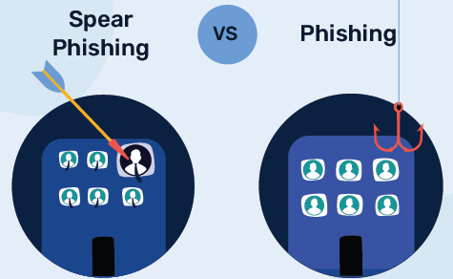
SPEAR PHISHING
Spear phishing is a more targeted form of phishing. Instead of sending emails to a large number of potential victims, attackers focus on a specific individual or organization. They use information gathered from various sources to make their messages more convincing and personalized.

Slide 7
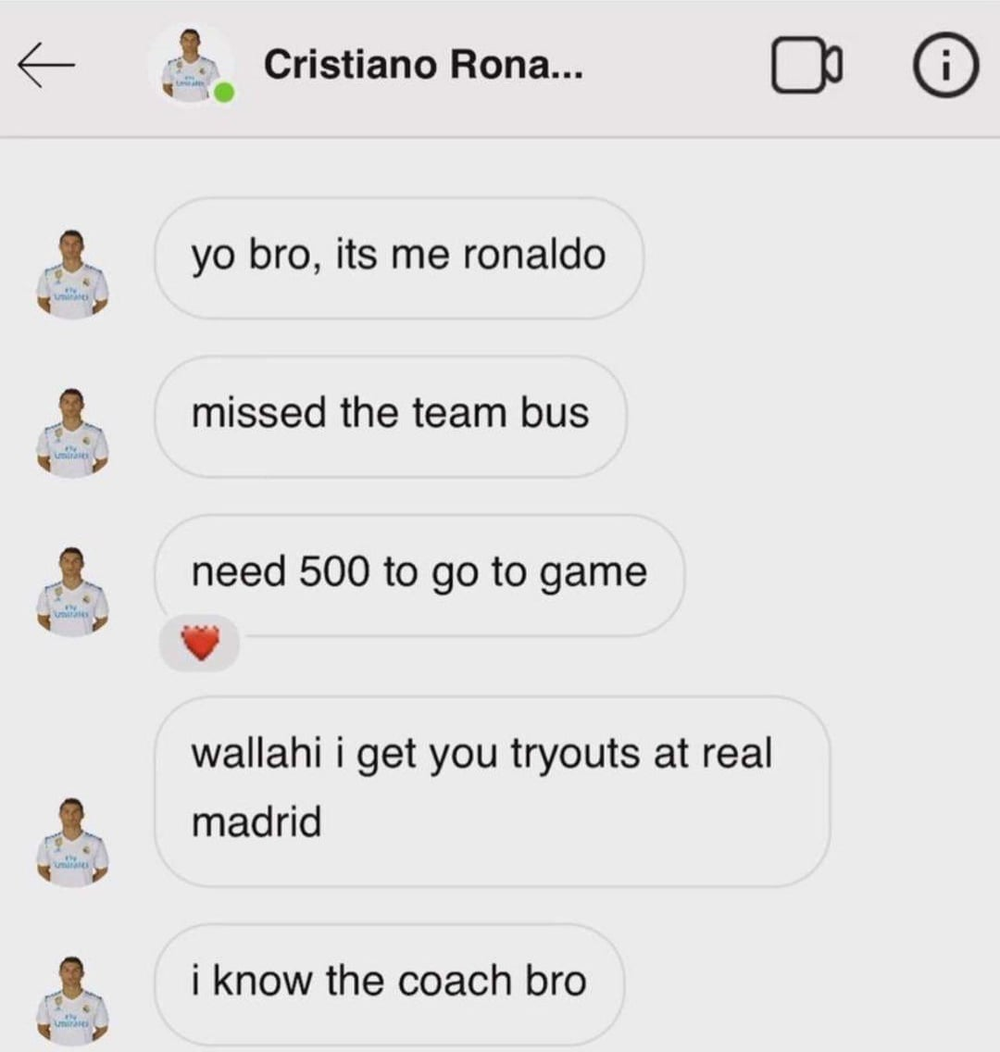
SPEAR PHISHING EXAMPLE & PREVENTATION
Ronaldo is a billionaire and does not need 500 Rs. EasyPaisa.
Ronaldo doesn’t live in Korangi to know who you are.
Such targetted accounts and texts are fake and scam.
Next time any Babar Azam or Jungkook texts you for money, report him right away.
Another Spear Phishing example is that “EasyLoad wali Saba in hospital.” (IYKYK)

Slide 8
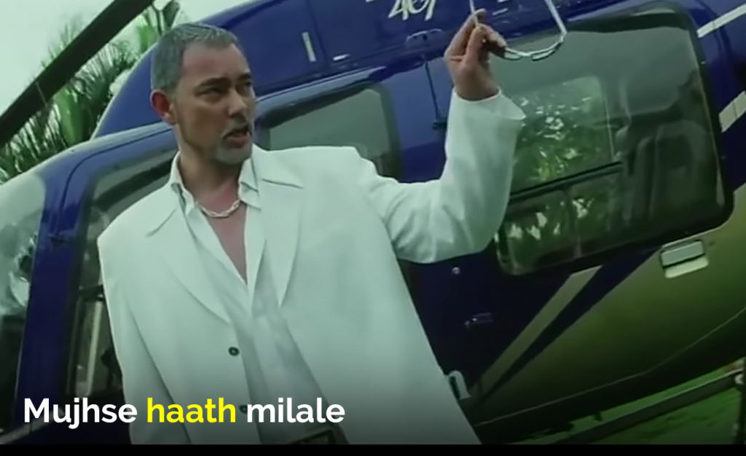
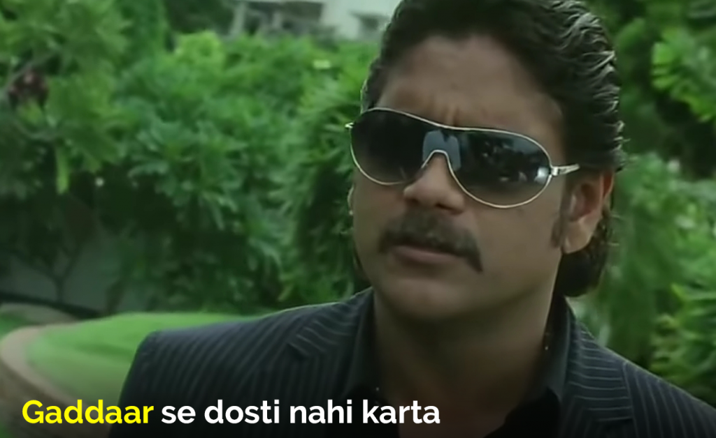
WHALING
Targetting the big fish i.e CEO of a company for money etc. They target the CEO to convince him for fake money partnership scams in order to steal the cash.
(The infamous whaling incident in the history of Cyber Security)

Slide 9
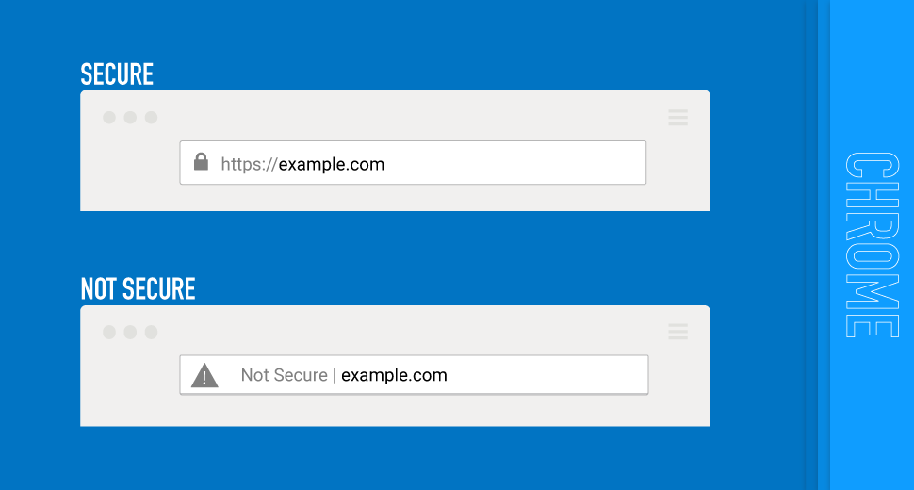
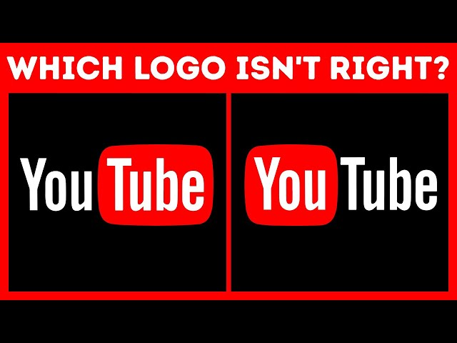
SPOTTING FAKE WEBSITES
Writing Facebook.com as Facebook.com.co
Writing an IP as a URL.
Writing Amazon.com as Amezon.com
All the grammar error replicas of sites are fake and scam.

Slide 10

SOCIAL ENGINEERING
Social engineering is the manipulation of people into revealing confidential information or performing certain actions, often through deception or psychological tricks. It exploits human psychology rather than technical vulnerabilities to gain access to sensitive data or systems.

Slide 11
THANKS!
Task 1 of CodeAlpha concludes here.
Do you have any questions?

